Slide 1

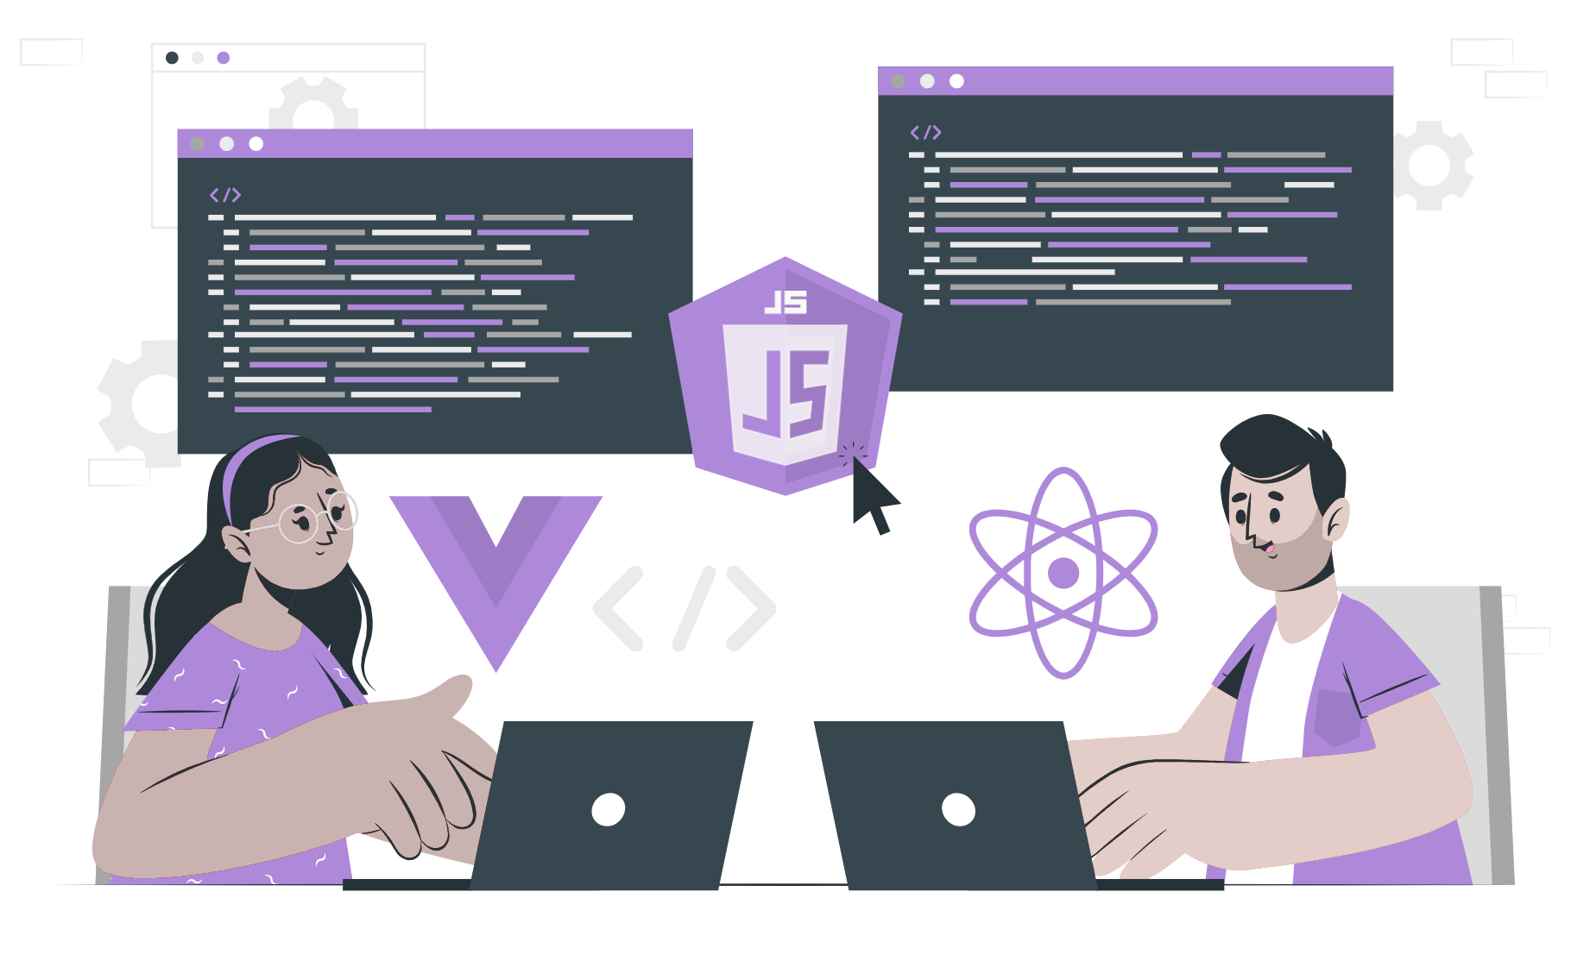
Background
Of React

Slide 2
What is React?
React is a Frontend javascript Library.
Jordan Walke, a Facebook software engineer is the creator of React.
It is well known for creating single page applications.
It is an open source component-based library.

Slide 3
Why React?
Easy To Learn
Flexible
Reusable UI components
Community

Slide 4
THANK YOU

